Slide 1
Flood Risk Analysis
Group 1: Harish Panneer Selvam, Matthew Eagon
Mathias Rav, Aaron Lowe, and Pankaj K. Agarwal. 2019. Flood Risk Analysis on Terrains. ACM Trans. Spatial Algorithms Syst. 5, 1, Article 2 (June 2019), 31 pages. DOI:https://doi.org/10.1145/3295459
Shekhar, Shashi. "Technical perspective: Progress in spatial computing for flood prediction." Communications of the ACM 63, no. 9 (2020): 93-93.
Notes:
More concise and expressive title slide
Bullet point Relation to this course- chap 2,4,6
Put paper in ending slide
Best paper award

Slide 2
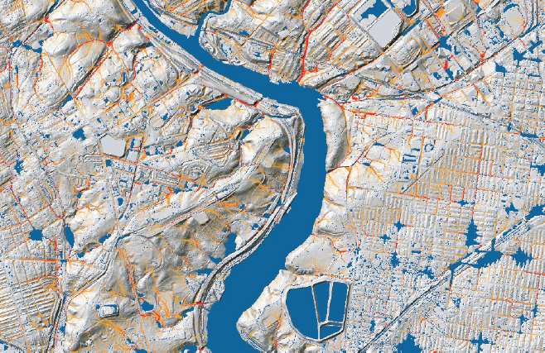
Problem Definition
Two different queries:
Terrain-flood query: Given a terrain and a rain pattern, find parts of terrain that get flooded
Point-flood query: Given a terrain, rain pattern and a query point, find if it will get flooded
Flood-time query: Find when, rather than if, a point will become flooded
Notes:
Possibly disclude this slide, or do not emphasize

Slide 3
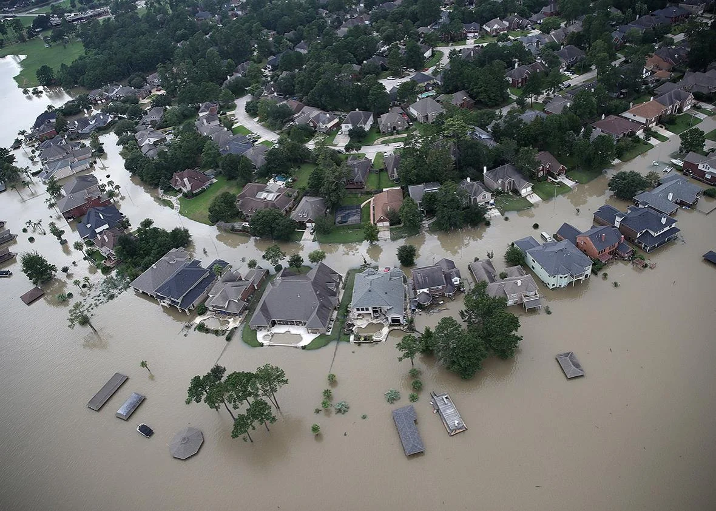
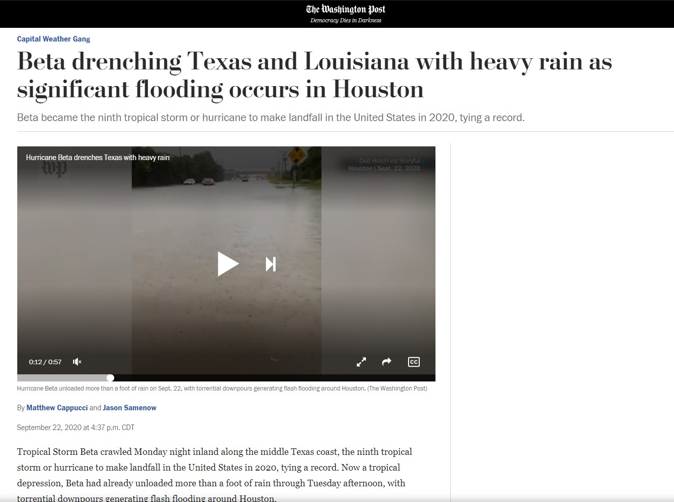
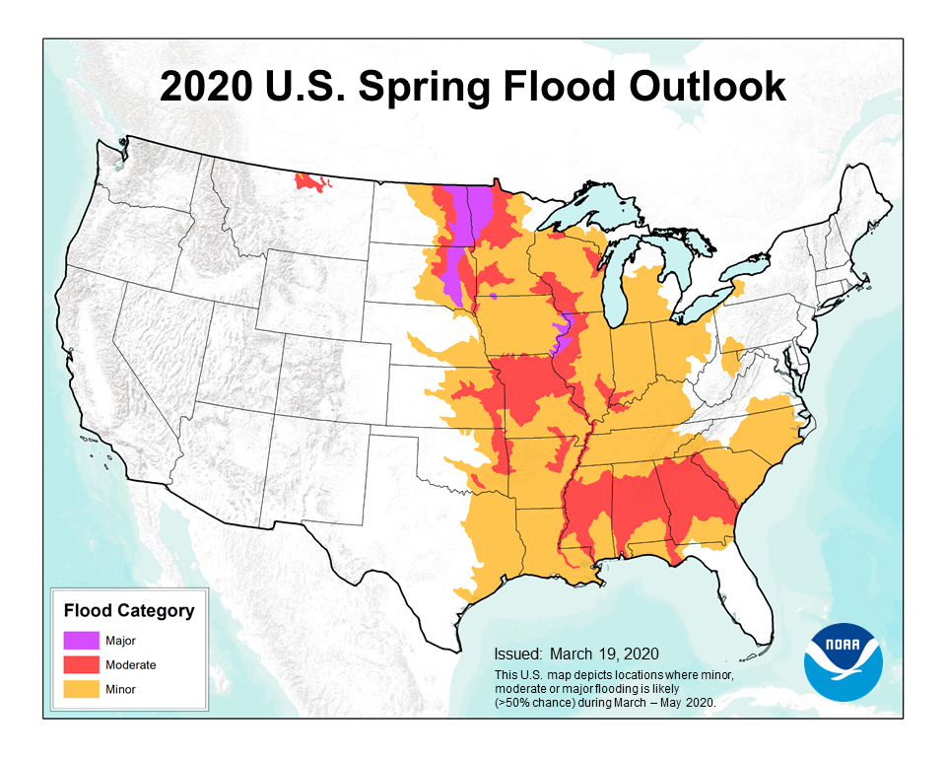
Motivation
Human and animal lives lost
Economic damage in billions of dollars each year
Climate change causes more severe floods
Affects decision to live at a place
Notes:
Emphasize article titles
Mention snow melt flood modeling, flooding in Minnesota/Iowa

Slide 4
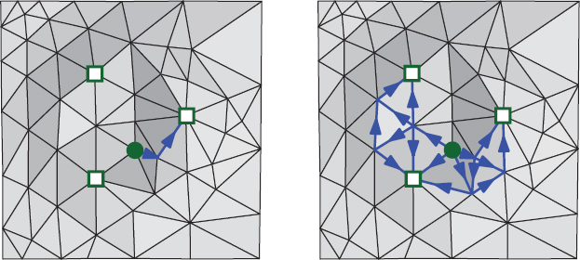
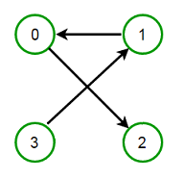
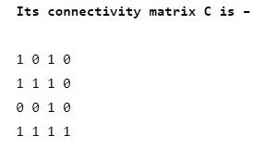
Key Concepts
Terrain data type: Graph structure of triangulated surface
Height function for node elevation
Single Flow and Multi Flow distribution: Rain falls at local maxima, and water flows along paths
Transitive closure: Given a graph, there is a directed path from nodes i to j.
Notes:
Not necessary to include transitive closure figure I think given the audience.

Slide 5
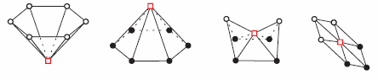
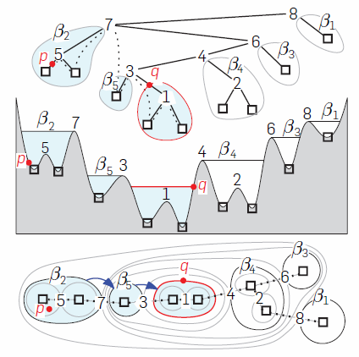
Technical Contribution
Sink, Maxima, Saddle, Regular vertices
Efficient construction of MFD merge tree structure using triangulated surface network with a linear height function
Designed scalable algorithms for terrain-flood, point-flood, and flood-time queries for MFD model.
Improved efficiency of algorithms for point-flood queries for SFD model.
Merge tree terrain representation
Notes:
Focus on construction of MFD merge tree.

Slide 6
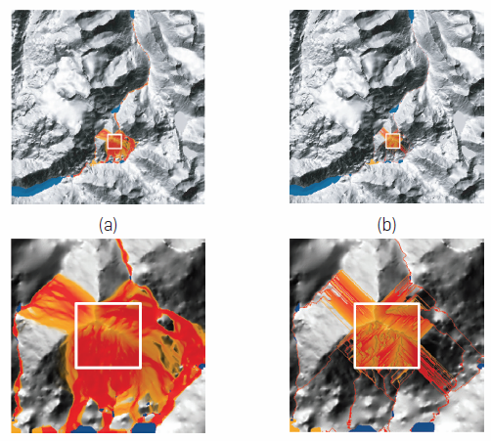
Results and Conclusion
MFD flooding (blue)
SFD flows (blue)
MFD model allows more realistic flooding pattern over larger areas.
New query algorithms are scalable.
Limitations
Does not account for drainage networks, only terrain elevation
Does not account for the velocity of water
Does not allow for channel flow
MFD flows
SFD flows

Slide 7
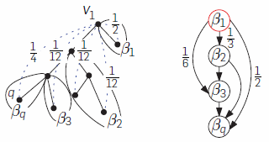
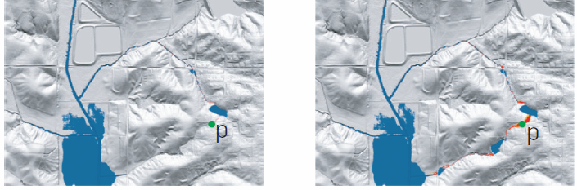
Connection to Spatial Data Science
Computes transitive closure of directed acyclic graph (merge tree) to allow flow from one node to multiple neighboring sinks.
Spatial data organization into DAG structure (merge tree)
Spatial queries utilizing graph structures
Transitive closure between tributaries
SFD flooding
Point p not flooded
MFD flooding
Point p flooded
Notes:
Emphasize transitive closure and its role in differentiating SFD and MFD.

Slide 8


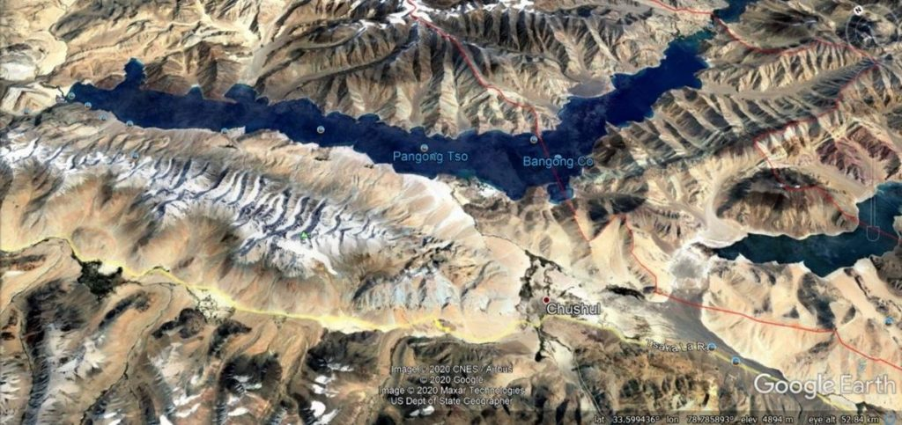
Connection to Other Fields
Spatial data visualization using GIS
Terrain data type useful in many other fields:
Analysis of presidential motorcade visibility
Complex surface geometries in CAD, 3D printing
Military strategic assessments of terrain
Notes:
Optional
Relation to ch.2 - terrain data type
Relation to ch.6 - SFD/MFD merge tree transitive closure DAG

Slide 9
Quiz
1 What is the terrain data type?

Slide 10
Quiz
2 What is not a benefit of using the MFD model?
Flood queries are more efficient for MFD
MFD has less approximation error than SFD

